Slide 1
Java CRISM Analysis Tool (JCAT) Tutorial
2021 Nov 01

Slide 2
Introduction to JCAT
JCAT serves as an analysis tool for data collected by the Compact Reconnaissance Imaging Spectrometer for Mars (CRISM) aboard the Mars Reconnaissance Orbiter.
JCAT works with:
Targeted Empirical Records (TERs) - image cubes derived from CRISM hyperspectral targeted observations, post-processed to standardize the illumination and observation geometry and remove atmospheric gas absorptions and instrument artifacts
Targeted Reduced Data Records (TRDRs) – image cubes containing data calibrated to radiance or I/F
Map-projected Targeted Reduced Data Records (MTRDRs) – TRDR image cubes containing map-projected TER data map-projected using terrain models of the Martian surface.

Slide 3
Introduction to JCAT
JCAT allows users to view and stretch image cubes, perform I/F comparisons, alter wavelengths set for image RGB, save data and images, perform atmospheric and photometric I/F corrections, and much more.
To read more about CRISM, JCAT, and data processing visit https://pds-geosciences.wustl.edu/missions/mro/crism.htm

Slide 4
Getting Started
JCAT requires Java 17 or later to run.
Any desired image file, along with its accompanying files, will need to be downloaded from the Planetary Data System (PDS) archive at Washington University in St. Louis. CRISM files may be upwards of 1 GB, so ensure there is sufficient space. These files should be placed in a folder called “JCAT” in the user’s home directory.

Slide 5
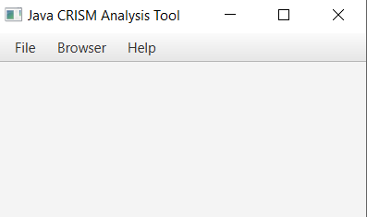
JCAT Window – main window
File
New – choose a downloaded file from home directory
Recent – select from a list of recently used files
Quit – close JCAT
Browser
CRISM Map – interactive CRISM web map
PDS Data Product Repository – only use if you know exact location of your file
PDS Data Product Search – search for images that meet your criteria
Help
Show Log – records actions taken by user, info and warnings
Documentation – show this .ppt
About – version, release date, authors

Slide 6
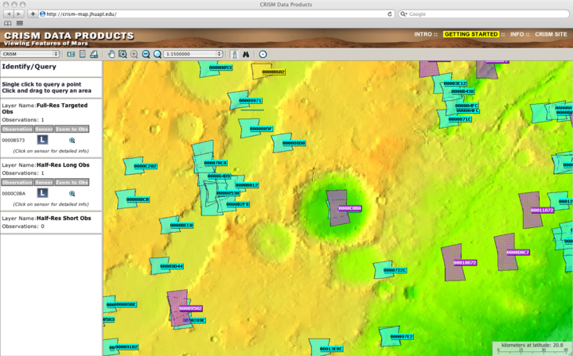
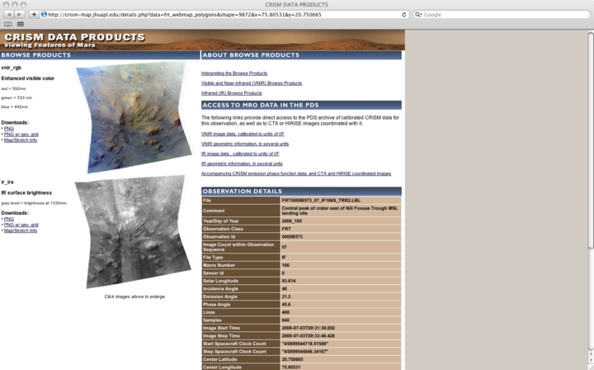
Getting New Files – CRISM Map
Browser -> CRISM Map, when you find an observation to download, choose the “i” icon in the toolbar and click the observation
You can click the binoculars to enter an ID directly
Click on the sensor to get detailed information on the observation

Slide 7
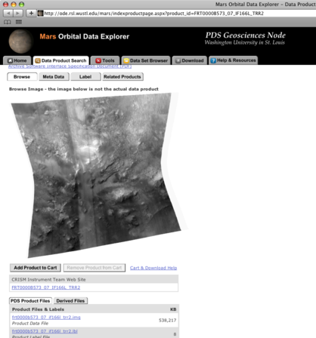
Getting New Files Cont’d
In “Access to MRO data in the PDS”, select either VNIR or IR image data depending on which sensor data you would like to view. This redirects to the Mars Orbital Data Explorer site at Washington University. See slides 9-10 for which files to download.

Slide 8
Using the Mars Orbital Data Explorer
You can also find CRISM data at https://ode.rsl.wustl.edu/mars/index.aspx
Select “Data Product Search”. You’ll find CRISM under Step 1: “Select One or Mode Desired Data Sets (Released PDS Archives) and then “Mars Reconnaissance Orbiter”
TRDR and TER files can be downloaded using “Calibrated Data”
MTRDR and MRDR files can be downloaded using “Derived Data”
Select a product ID or explore CRISM data in a geographic or temporal range using the options in Step 2.
Select your products and enter your email address. You will be sent a download link when your products are ready.

Slide 9
Necessary Files: MTRDRs
Download to home directory/or JCAT folder. These will all be located in the same subdirectory on the PDS archive page. Below is an example of the necessary files for an MTRDR observation.
MTRDR - MTRx
(if) .img, .lbl
frt0001ecba_07_if166j_mtr3.img
frt0001ecba_07_if166j_mtr3.lbl
(wv) .tab
frt0001ecba_07_wv166j_mtr3.tab
(su) .img, .lbl – OPTIONAL
frt00020c77_07_su166j_mtr3.img
frt00020c77_07_su166j_mtr3.lbl
x = version number
‘if’ files store the intensities (I/F values)
‘wv’ files store the wavelengths
‘su’ files for MTRDRs are optional – they show summary parameters and browse products (slides 25-26 and 29-30)

Slide 10
Necessary Files: TRDRs and TERs
For TRDR and TER files, there are two steps. First, you will need to download the ‘if’ files (and ‘wv’ for TER) located under PDS Product Files. Then, you will need the accompanying DDR files. To find these, go to related products and scroll down – they will take the form of frt00021da6_07_de166l_ddr1.img. Below are examples of the necessary files for a TRDR observation and a TER observation.
TRDR – TRRx/DDRx
(if) .img, .lbl
hrl0002422e_07_if182l_trr3.img
hrl0002422e_07_if182l_trr3.lbl
(de) .img, .lbl
hrl0002422e_07_de182l_ddr1.img
hrl0002422e_07_de182l_ddr1.lbl
TER – TERx
(if) .img, .lbl
frt00021da6_07_if166j_ter3.img
frt00021da6_07_if166j_ter3.lbl
(wv) .tab
frt00021da6_07_wv166j_ter3.tab
(de) .img, .lbl
frt00021da6_07_de166l_ddr1.img
frt00021da6_07_de166l_ddr1.lbl
x = version number
‘if’ files store the intensities (I/F values)
‘wv’ files store the wavelengths
‘de’ files are the DDRs, they are necessary for lat/lon conversions

Slide 11
New Files: Mac Only
Filename extensions on Mac are different than windows. Go to Finder -> Preferences -> Advanced -> Show all filename extensions
This allows you to change label and tab files to .lbl/.tab instead of .txt.
You will be asked to either keep .txt or use .lbl/.tab. Be sure to use .lbl/.tab.
Example:
“hrl00018570_07_if182l_trr3.lbl.txt” will appear after downloading, but needs to be changed to “hrl00018570_07_if182l_trr3.lbl”

Slide 12
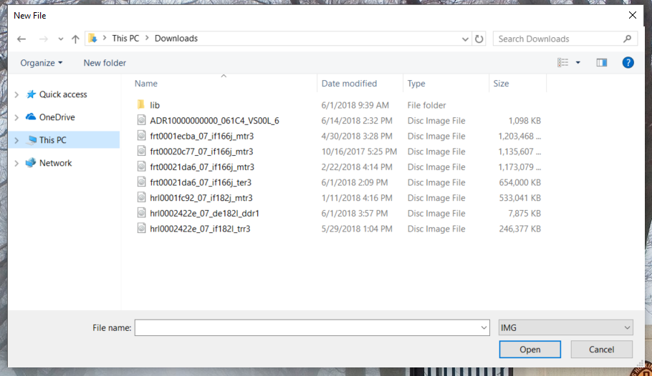
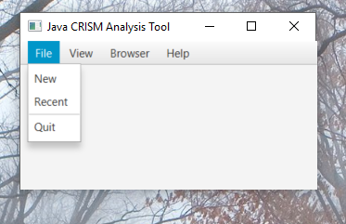
Opening New Files
File-> New, choose the image file you would like to view from your home directory

Slide 13
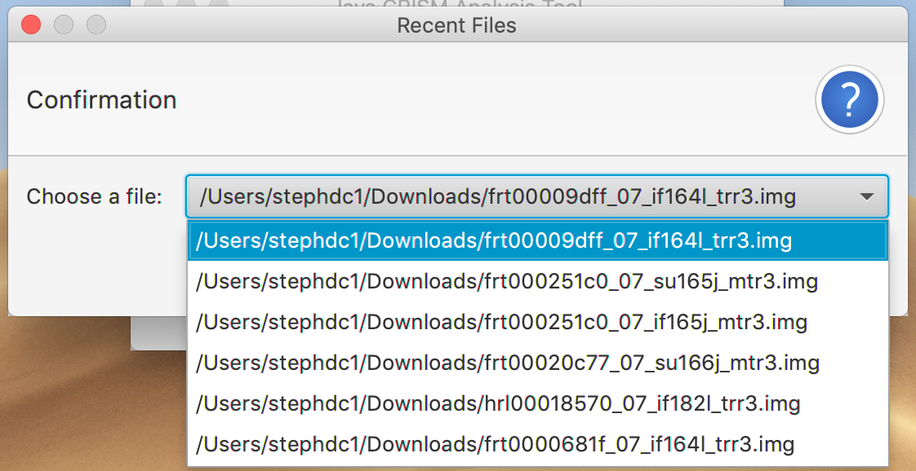
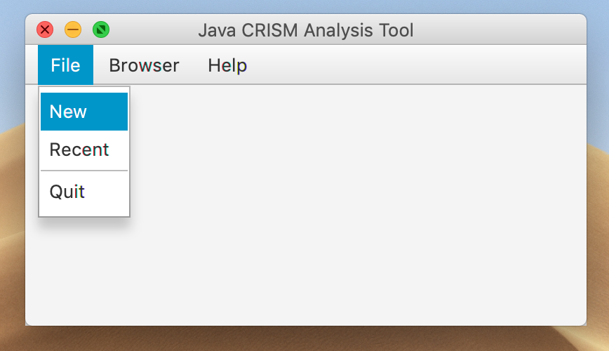
Choosing a Recent File
File -> Recent, a list of recently loaded files will be shown. If the location of a file has changed since you last used it. You will need to read it in like a new file.

Slide 14
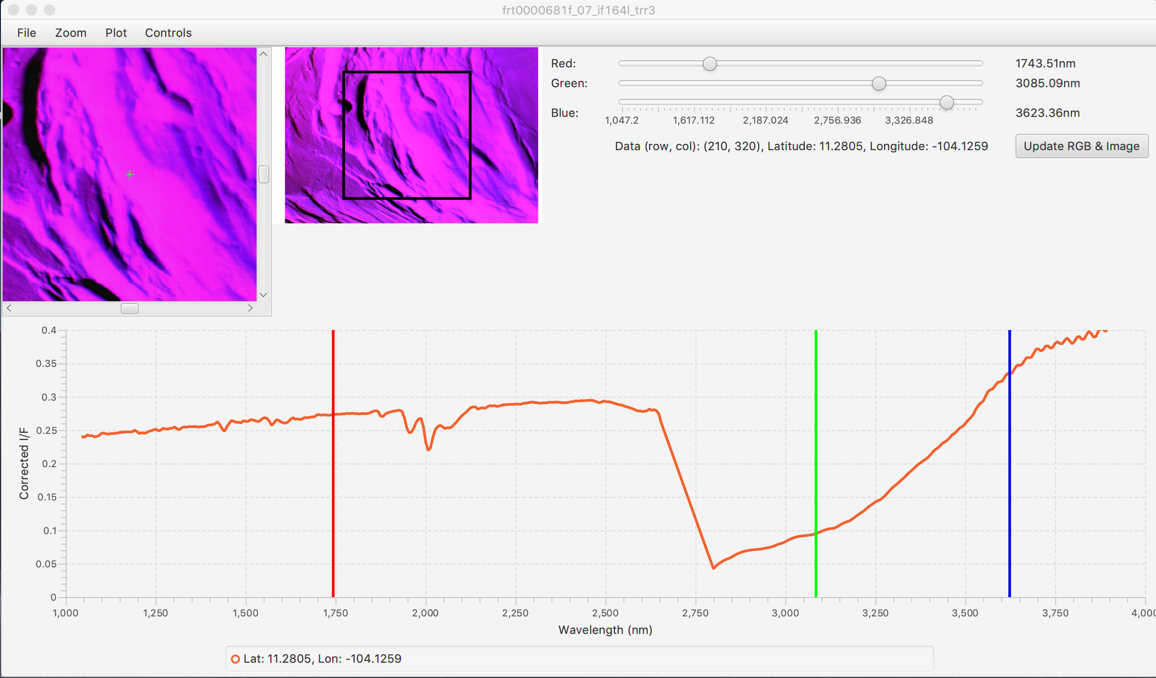
JCAT Image Frame
File
Expand Image
Upon loading, a zoomed-in image(left) and reference image(right) are shown.
To view full-size image window, File -> Expand Image.
Save Image – saves current image as .png file
Save Spectral Data – saves single or all spectral values to a .csv file
Save Chart – saves screenshot of line chart as .png file
Zoom – zoom in/out on image
Plot
Reset scale – scales X, Y or both axes to default
Set X/Y Scale – user-set range of values within view on spectrum

Slide 15
JCAT Image Frame Cont’d
Controls
Contrast – image is loaded in with a default 1 percentile stretch
Linear – set dimmest pixels to 0 and brightest to 255
1, 2, Custom Percentile Stretch – sets the dimmest x %ile to 0 and brightest x %ile to 255
Spatial Subset Stretch – toggles on/off, will perform desired linear/percentile stretch based on the subset of image pixels within viewing frame (top left)
Spectrum Averaging Size – either see 1x1, 3x3 or 5x5 pixel box, useful to reduce noise
Spectrum Options – choose between single or multiple spectra layered on graph
Spectral Interest
Click – Plots the intensity of single click (1x1, 3x3, or 5x5 box)
Drag Avg – Averages the I/F of pixels within a rectangle dragged by user
Region of Interest – Averages the I/F of pixels within a region specified by user
Manual Input – user inputted points
Mouse Button Instructions – explanations of how to use spectral interest options
Spectrum Operations – add, subtract or ratio two different spectra
ATP Corrections – only available if viewing a TRDR image
Atmospheric – correction for absorption by CO2 in atmosphere (IR detector only ~2 microns)
Thermal – currently no working thermal corrections
Photometric – correction to radiance for non-normal solar incidence: (I/F)/cos(incidence angle)

Slide 16
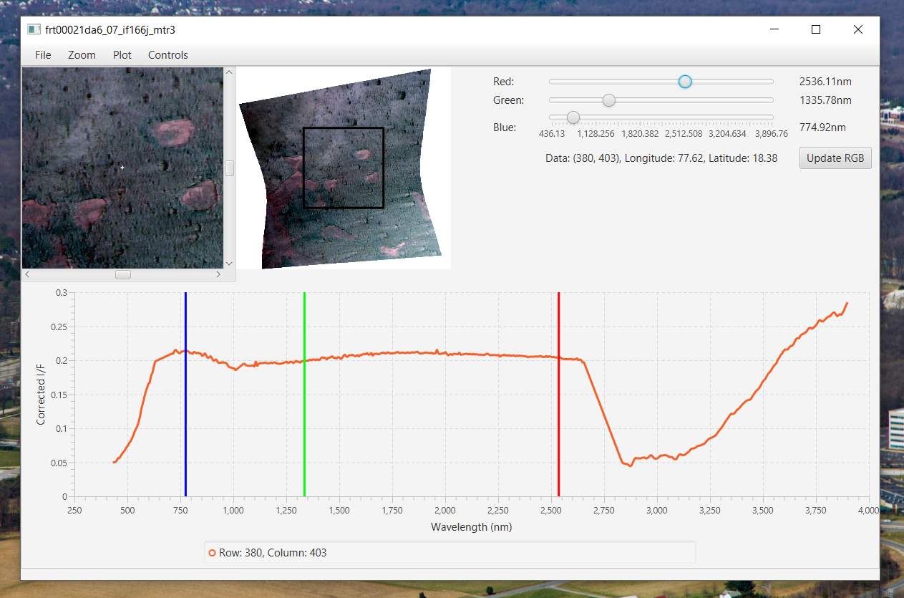
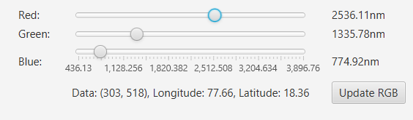
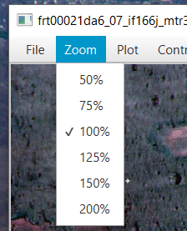
Navigating the Image Frame
Zoom in/ out using the zoom menu, the reference rectangle on the right image will adjust accordingly.
The right side contains three sliders to select the wavelengths for red, green, blue. Press ‘Update RGB & Image’ values to apply RGB to the image and their positions on the bottom spectrum.

Slide 17
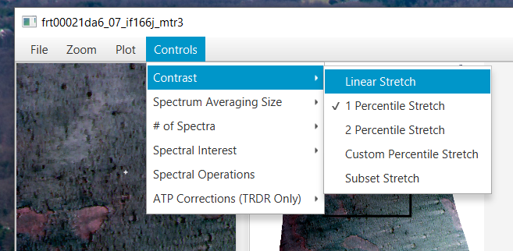
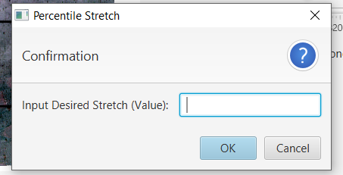
Navigating the Image Frame Cont’d
The images are loaded in with a default 1%ile stretch – dimmest and brightest 1%ile of pixels are set to 0, 255 respectively.
For stretch options, Controls -> Contrast
Linear stretch: dimmest pixel -> 0, brightest pixel-> 255
Percentile Stretches: dimmest x%ile -> 0, brightest x%ile -> 255
Subset Stretch – When selected, stretches are applied based on the dimmest and brightest pixels within the viewing frame(top left), rather than the entire image
The pixels used to apply the subset stretch will be shown under the ‘Update RGB & Image’ button
Click the ‘Update RGB & Image’ button to apply stretches and changes on RGB sliders

Slide 18
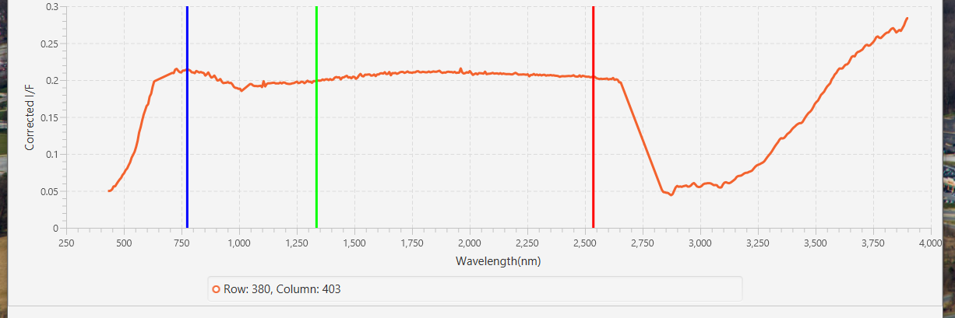
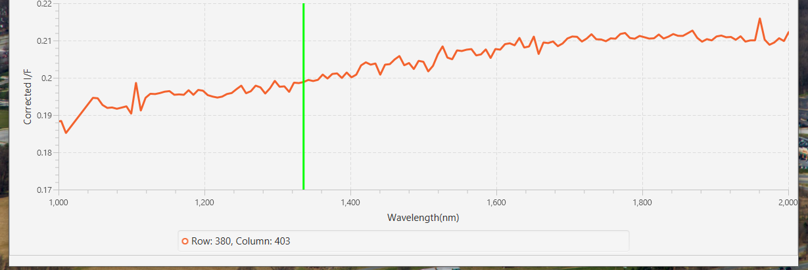
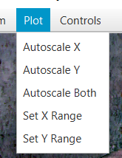
Navigating the Image Frame Cont’d
Spectrum on bottom displays intensity as a function of wavelength.
Use the plot menu to change the axes.
Auto-scale reverts axes back to original ranges.

Slide 19
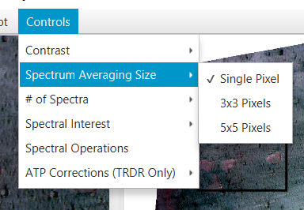
Navigating the Image Frame Cont’d
Click anywhere on the image to get that pixel’s spectrum. The legend will show the position of the pixel.
To reduce noise, you can change the spectrum averaging size. The 3x3 and 5x5 boxes average the surrounding 8 or 24 pixels.
The change will be reflected by the latitude and longitude ranges in the legend.

Slide 20
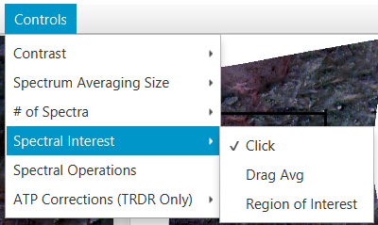
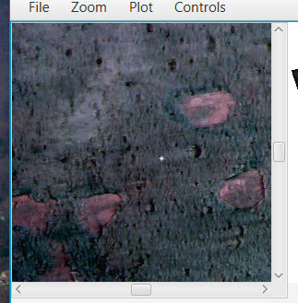
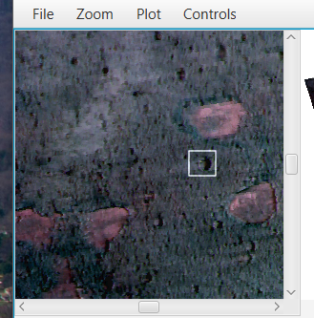
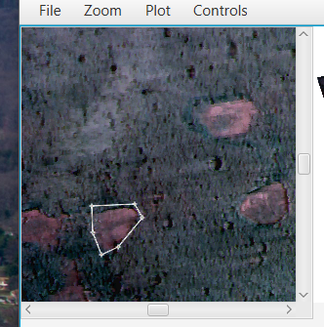
Navigating the Image Frame Cont’d
NOTE: A three button mouse is recommended. Not all capabilities will be available otherwise.
Aside from the click option, there are ‘Drag Avg’, ‘Region of Interest’, and ‘Manual Input’ options.
Drag Avg (middle) allows user to drag across the image to create a rectangle. The pixels within the rectangle will be averaged.
Region of Interest (right): Left click to add a new point to the shape. To close the shape, right click and the last point will connect to the first point. Pixels inside the shape will be averaged.
Manual Input allows you to type in points you’d like to view. Follow the format: ‘row, col’
If entering multiple points, put each on a separate line

Slide 21
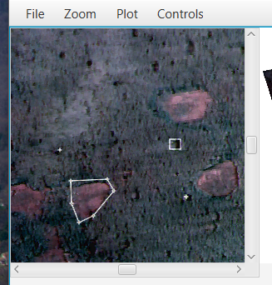
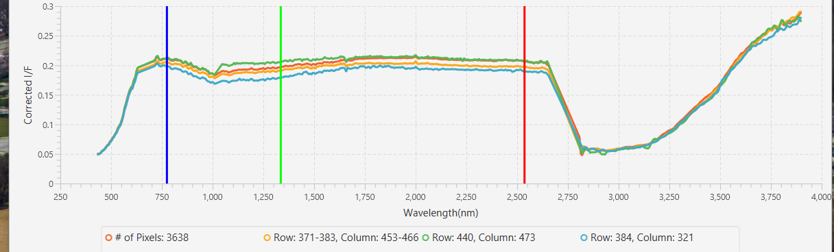
Navigating the Image Frame Cont’d
To layer multiple spectra on the chart, Controls -> # of Spectra -> Multiple. Only the Click and Drag Avg features are available for the additional spectra. Center click or drag to add the spectrum.
To clear, left click on the image again. The new pixel’s spectrum will appear and the previous spectra will all be removed from the chart.

Slide 22
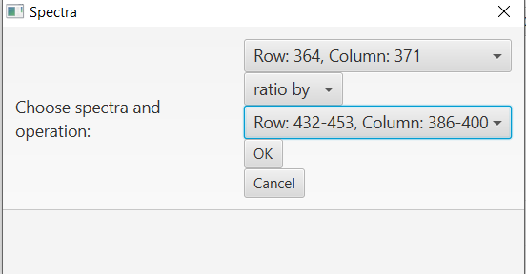
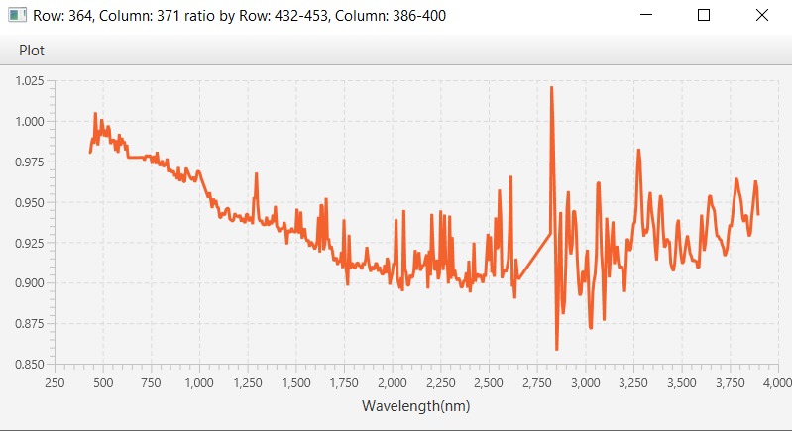
Navigating the Image Frame Cont’d
To add, subtract or ratio spectra, select Controls -> Spectral Operations.
Select the spectra and operation you’d like to perform.
Axes scaling features are available under the Plot menu.
Use the file menu to save the data or chart to a .csv or .png file

Slide 23
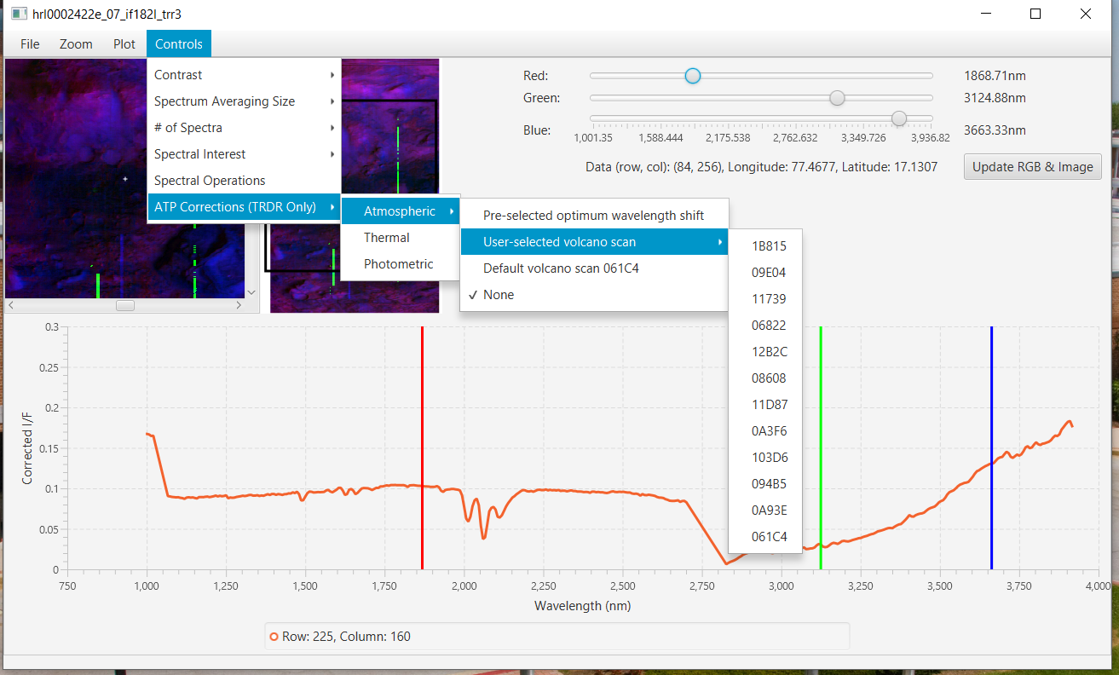
Navigating the Image Frame Cont’d
Under Controls, there are ATP Corrections. These are only applicable for TRDR files.
Atmospheric corrections remove the attenuation of surface brightness by atmospheric gases, mainly carbon dioxide and water vapor. They use a scaled measured brightness ratio of the summit and base of Olympus Mons ("volcano scan correction") to represent attenuation by atmospheric gases. The effects can be seen in the dips around 2 microns. (For longwave sensor TRDR files only)
Currently, there are no working thermal corrections.
Photometric corrections transform the spectrum of reflected sunlight to what it would be if the Sun illuminated the surface at a normal incidence angle (if the Sun was overhead)

Slide 24
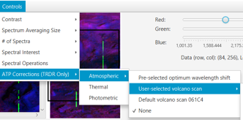
Navigating the Image Frame Cont’d
Atmospheric Corrections:
Pre-selected optimum wavelength shift – runs a routine to find the volcano scan with the minimum shift artifact due to tiny changes in the instrument over time. This is the recommended choice.
NOTE: if not previously paired with a volcano scan, routine may take time
Will save paired files so routine is only performed once
User-selected – select from a list of available volcano scans
Default – this is the 061C4 volcano scan

Slide 25
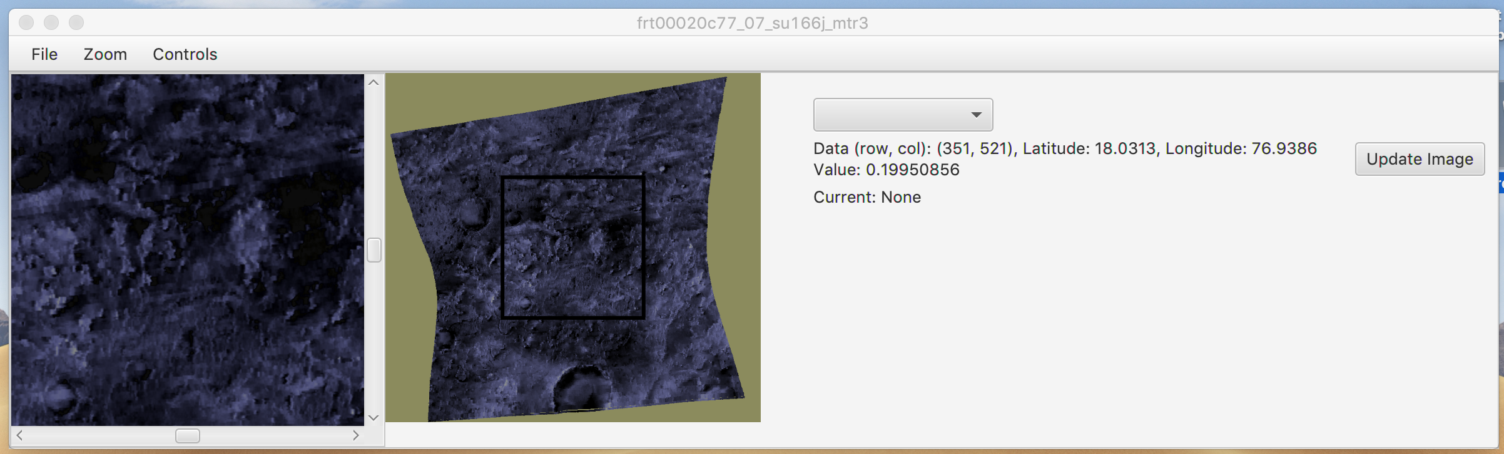
Summary Parameter Image Frame(MTRDR)
A summary parameter image shows strength of a mineral absorption or other spectral feature. Read more about summary parameters at: https://agupubs.onlinelibrary.wiley.com/doi/full/10.1002/2014JE004627
For MTRDR images, su types will open a new window (e.g. frt00020c77_07_su166j_mtr3.img)
Upon loading, a zoomed-in image(left) and reference image(right) are shown. To view full image, File -> Expand Image.
The right side contains a drop-down menu to select a summary parameter. To the right of the slider is the selected parameter. Press ‘Update Image’ to apply the selected parameter to the image.

Slide 26
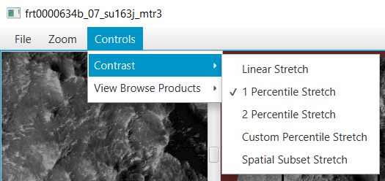
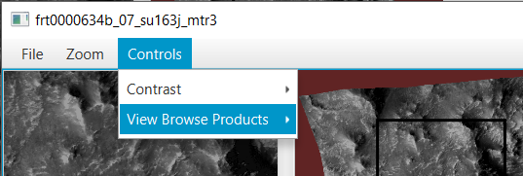
Summary Parameters Frame(MTRDR) Cont’d
Zoom in/ out using the zoom menu, the reference rectangle on the right image will adjust accordingly.
The images are loaded in with a default 1%ile stretch , same as main ‘if’ image
Same stretch options are available here
Click the ‘Update Image’ button to apply selected stretches and summary parameters.
To view the browse products select “View Browse Products”

Slide 27
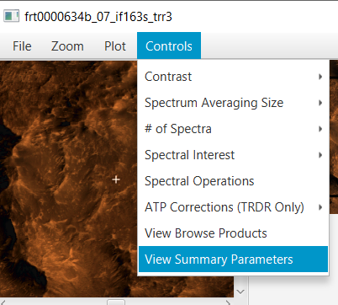
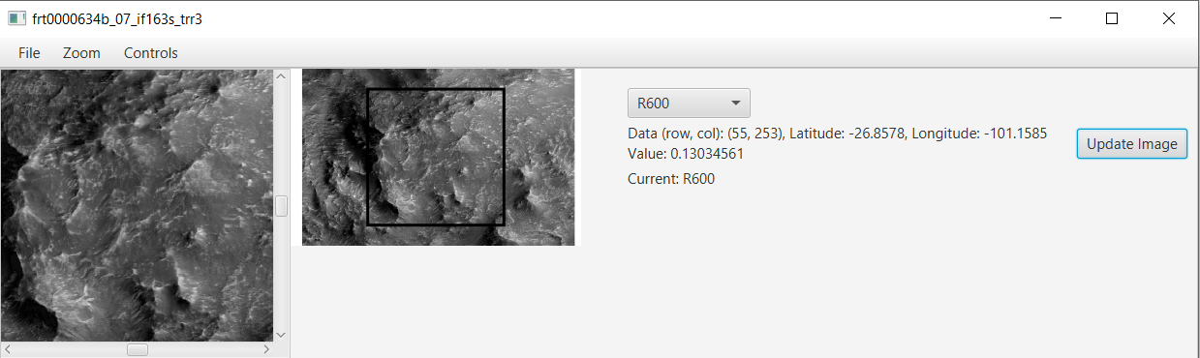
Summary Parameters (TRDR)
To view summary parameters for TRDR files select “View Summary Parameters” in the controls menu of the main ‘if’ image window
Sum param values are located under the lat/lon information

Slide 28
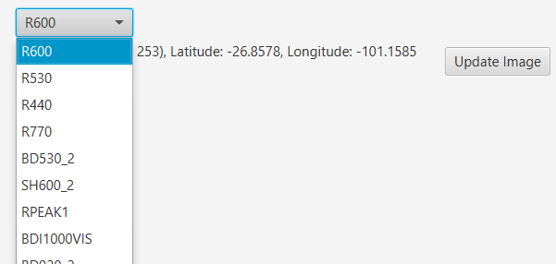
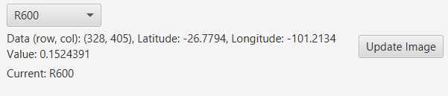
Summary Parameters Cont’d
Select a summary parameter from the list and click the “Update Image” button to continue.
Contrasts can still be selected from the controls menu
Sum param values are located under the lat/lon information
NOTE: RPEAK1, BDI1000VIS, BDI1000IR, VAR and BDI2000 are currently not available for TRDR products

Slide 29
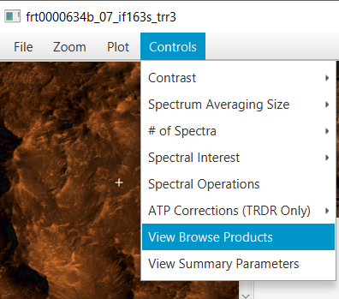
Browse Products
Browse products are standard, thematic combinations of summary products that show variations in the presence of a related class of minerals. See more at https://agupubs.onlinelibrary.wiley.com/doi/full/10.1002/2014JE004627
For MTRDR files, select “View Browse Products” once you’ve opened the summary parameters window
For TRDR files, select “View Browse Products” to launch the browse products window

Slide 30
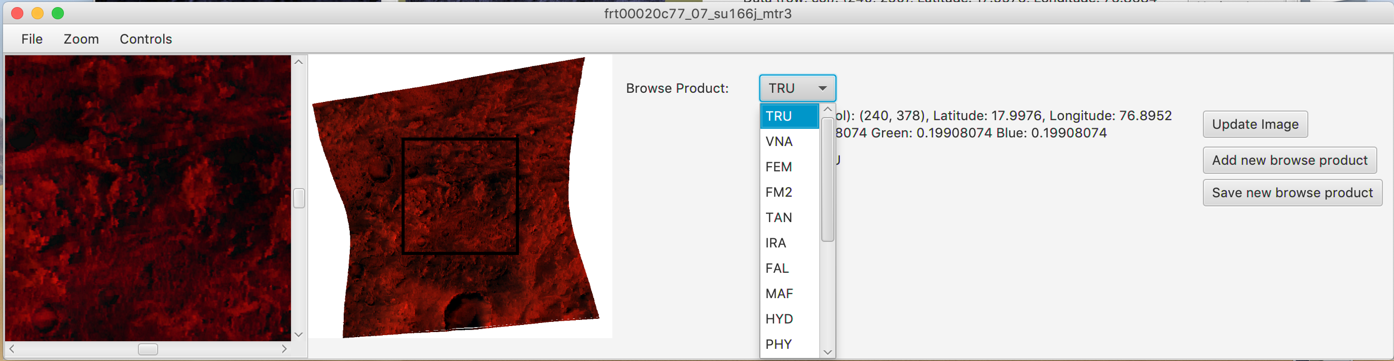
Browse Products Cont’d
Select from the list of browse products and click the update image button to display the image
RGB values are shown to the right
By selecting new browse product, choose which summary parameters will be the RGB values. ”Update image” will display new browse product
Option to save and label new browse product

Slide 31
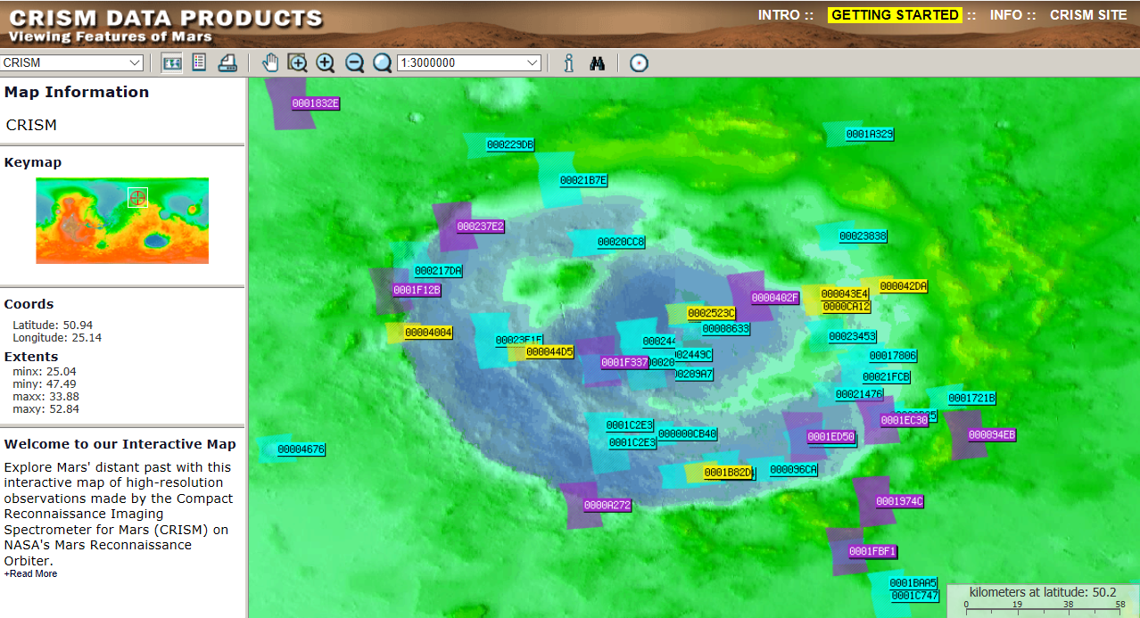
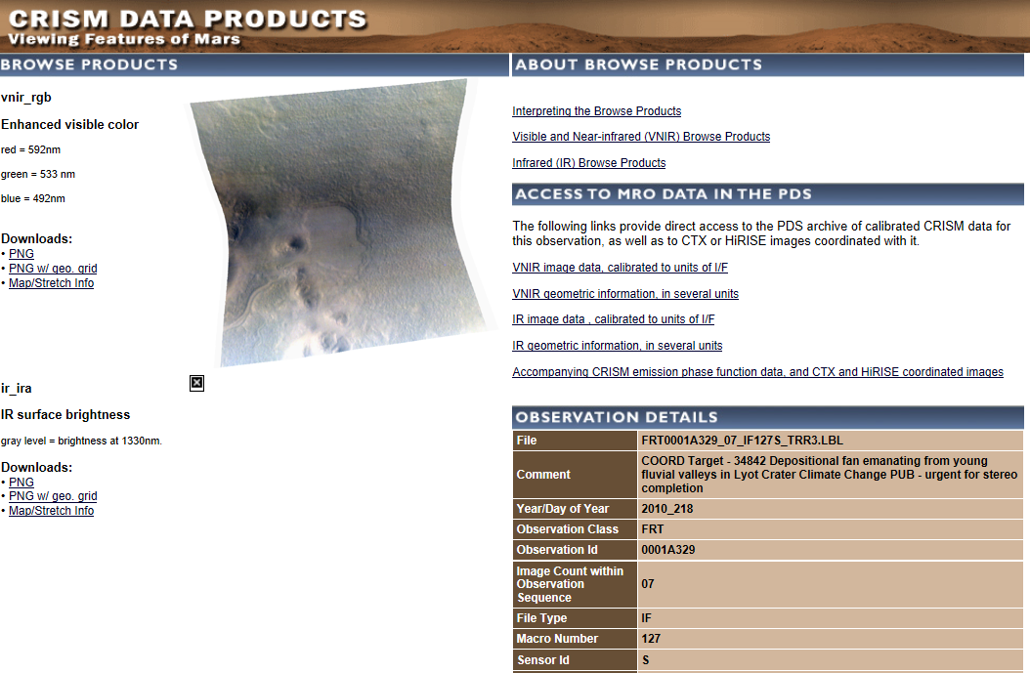
Example Workflow – Retrieving Files
Let’s take a look at the interactive CRISM map (Browser -> CRISM Map)
If we zoom in to around 52.3, 31.0 (lat, lon), we can download observation 0001A329 in the top right, click on the sensor, then choose the VNIR image data
Refer back to slides 5-11 for how to download the necessary files for a CRISM images
Select this as a new file in JCAT when downloaded

Slide 32
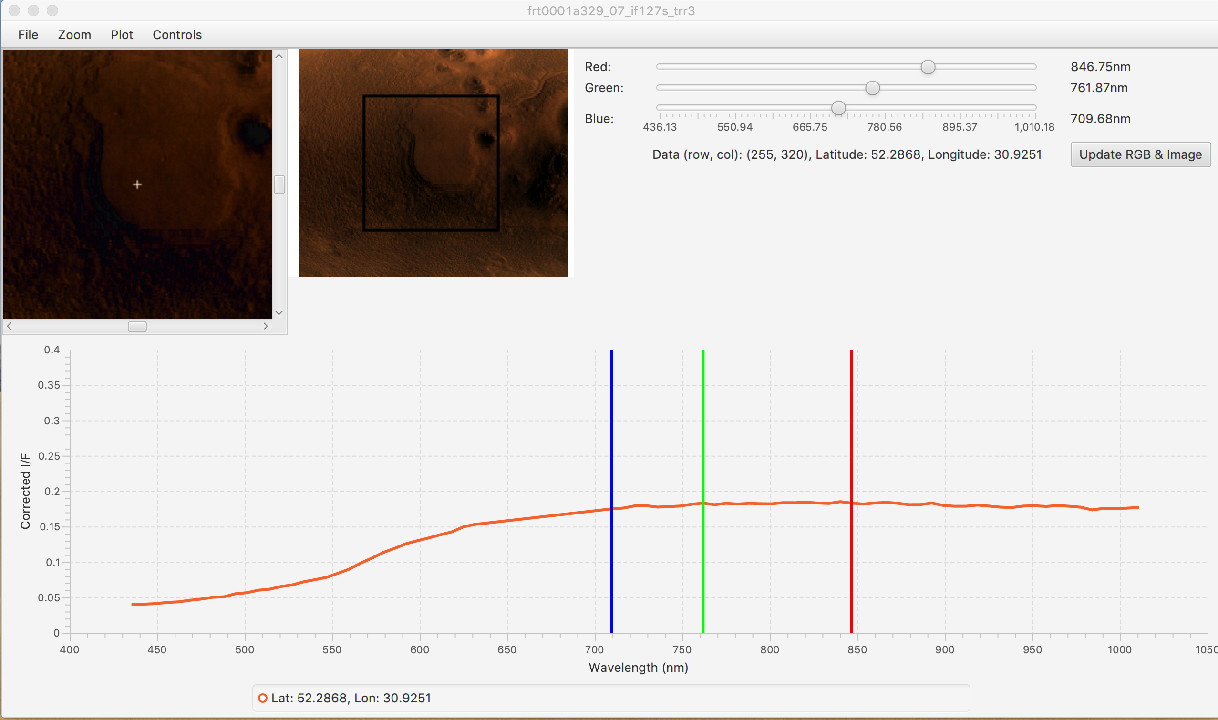
Example Workflow
The image will load in the upper left corner. Clicking on a point will show the spectrum on the bottom and be reflected on the image with a crosshair.
You may zoom in/out using the zoom menu or expand the image to its full size under the file menu.
Images are loaded in with a default 1%ile stretch meaning the dimmest pixels are assigned minimum brightness (0) and brightest assigned maximum brightness (255).
The sliders in the upper right allow you to manipulate the wavelengths set for red, green and blue. Slide them around and update the image to see their effect.

Slide 33
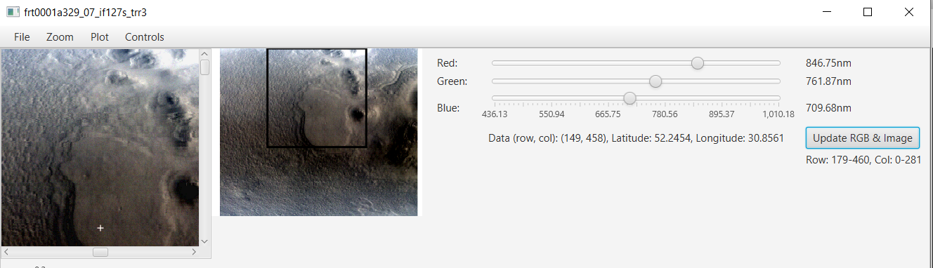
Example Workflow
Try some of the different stretching options under Controls->Contrast. The spatial subset stretch uses only the pixels within the viewing range to assign minimum and maximum brightness instead of the entire image. These tools are helpful to see different spots that may be more present at one band than another.

Slide 34
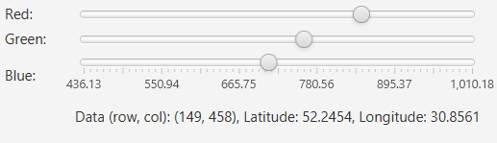
Example Workflow
Let’s take a look at the values underneath the RGB sliders.
The Data points refer to the image scene. The origin (0, 0) is in the upper left of the image.
The latitude and longitude coordinates are also displayed. Be careful- up, down, right, left don’t always correspond to North, South, East and West.

Slide 35
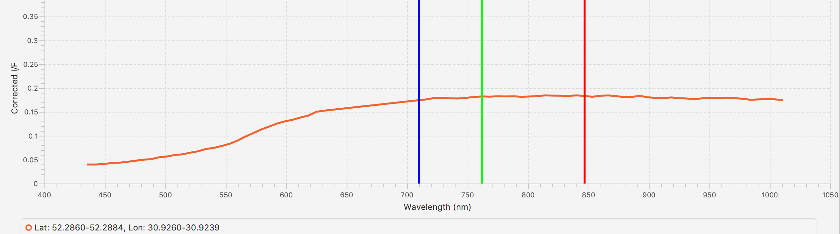
Example Workflow
Go to Controls -> Spectrum Averaging Width. It is currently set to Single Pixel. This means just the pixel clicked will have its spectrum shown.
Choose 5x5 Pixels. This will average the selected pixel with its surrounding 24 pixels, creating a 5x5 box. This is very useful to reduce noise in the image that may not carry any information. The new averaged area will be reflected in the legend of the chart.

Slide 36
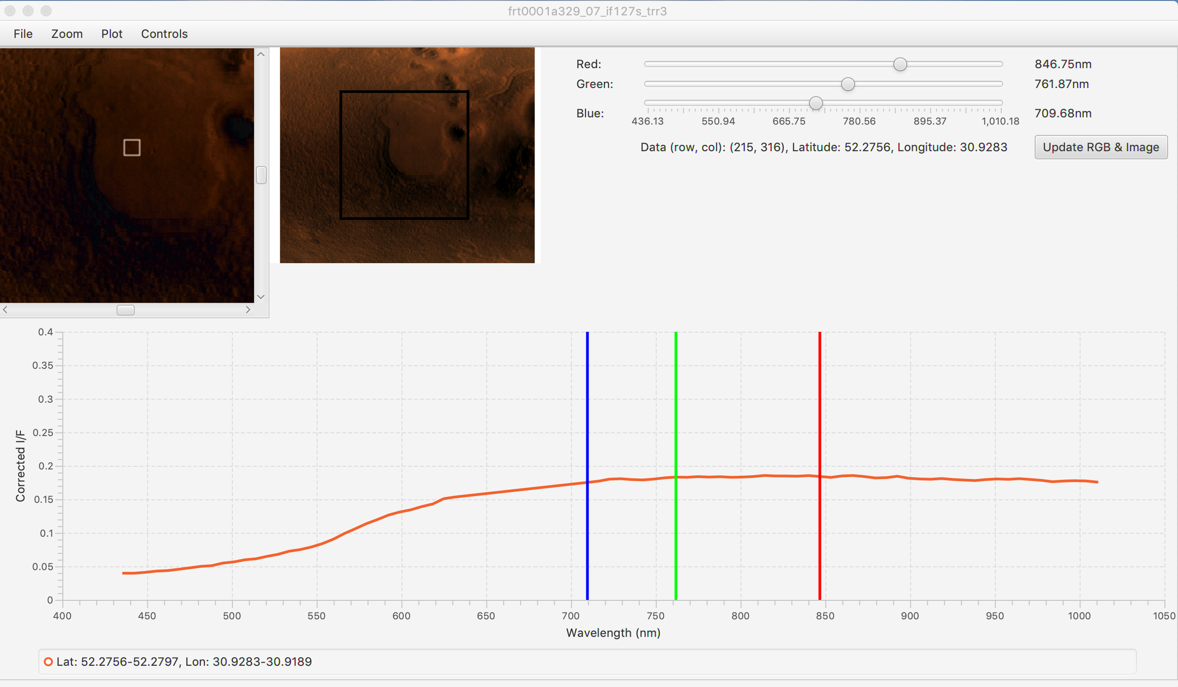
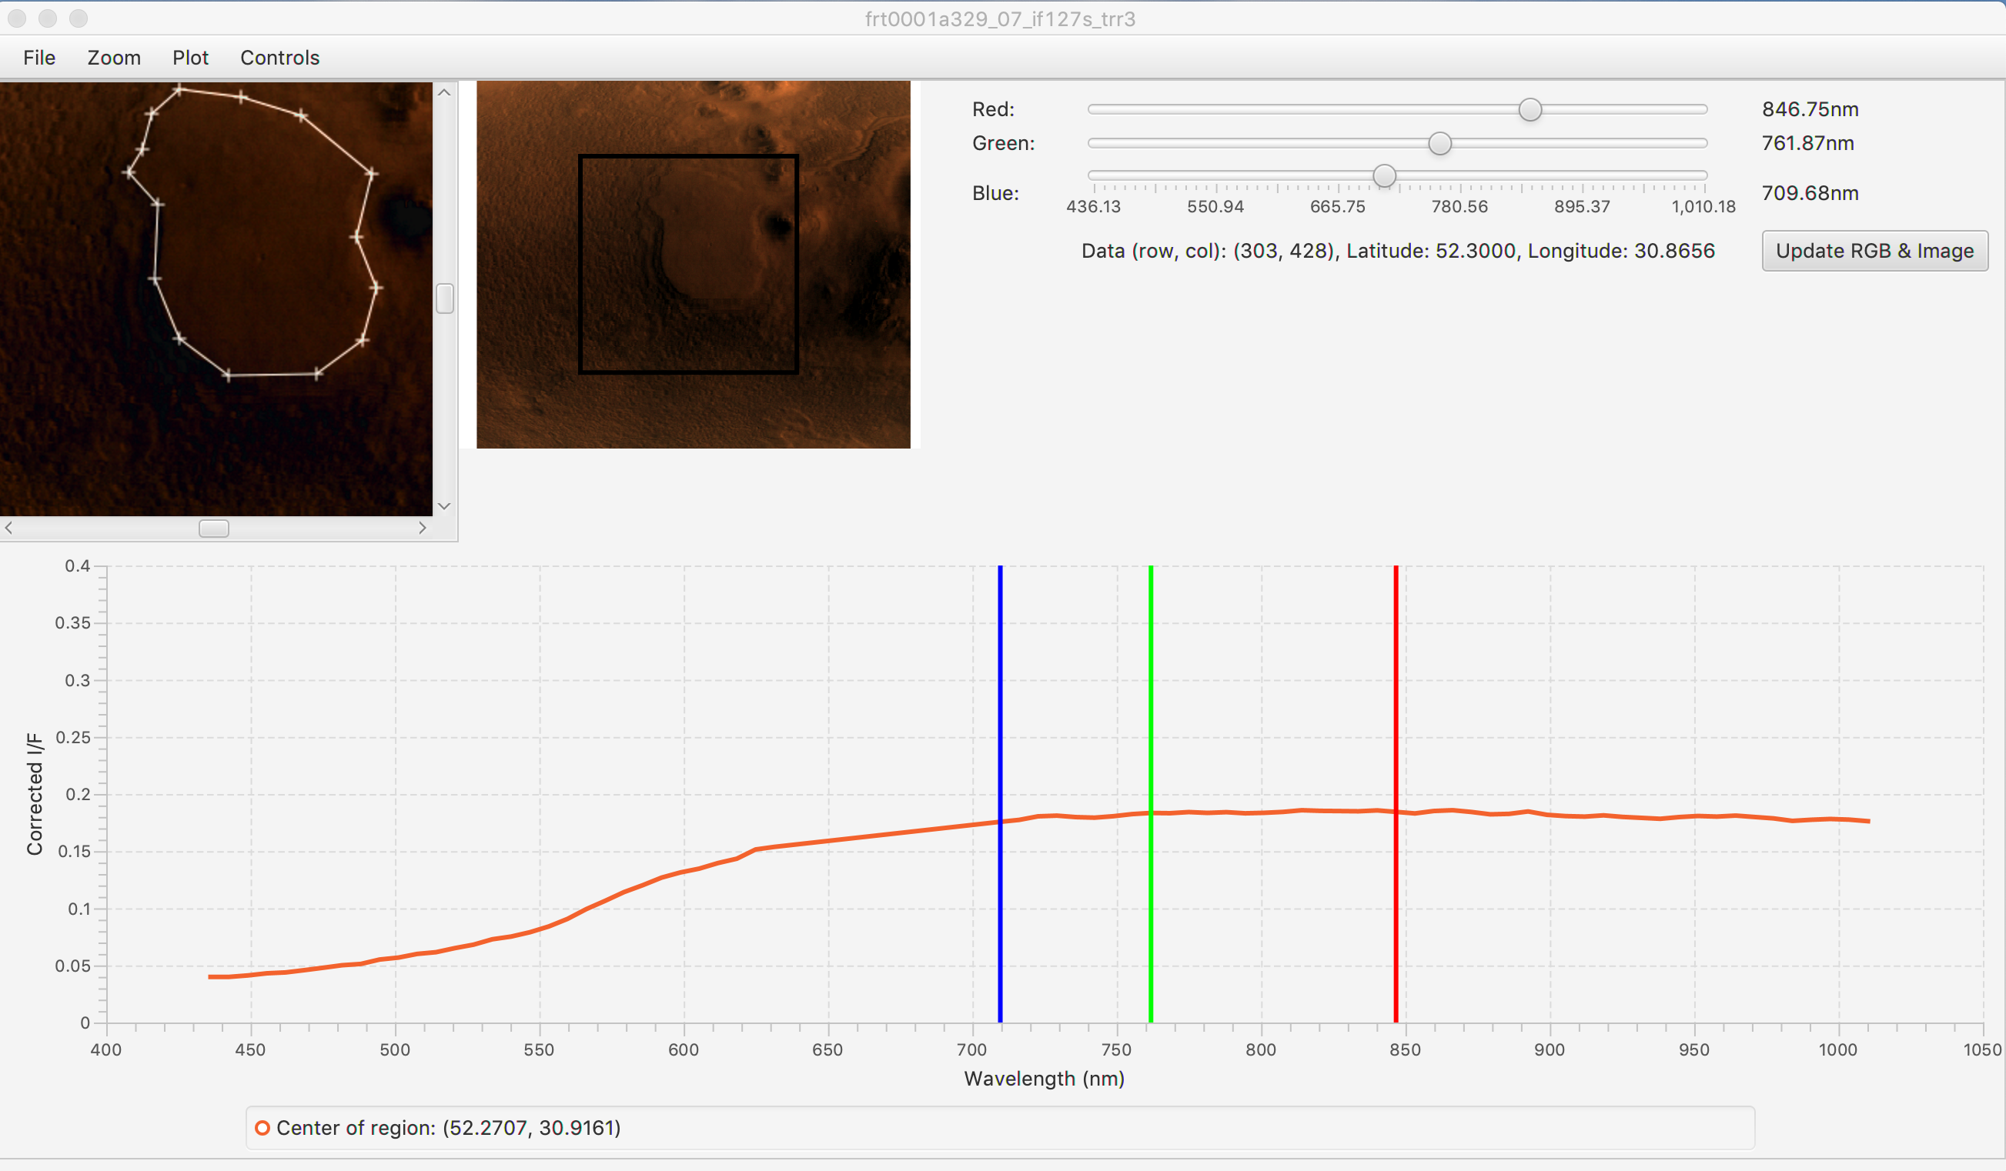
Example Workflow
Let’s use average a larger area. Choose Controls -> Spectral Interest -> Drag Avg. Now, instead of clicking, press drag and release on the image to average the pixels within the rectangle you just created.
In order to use the Region of Interest tool, left click to add points to the shape. To close the shape, right click and the last point will connect to the first, averaging the pixels inside. Try clicking around the large mound in the center of the image.
Know that these may take longer since they are averaging many more pixels than before.

Slide 37
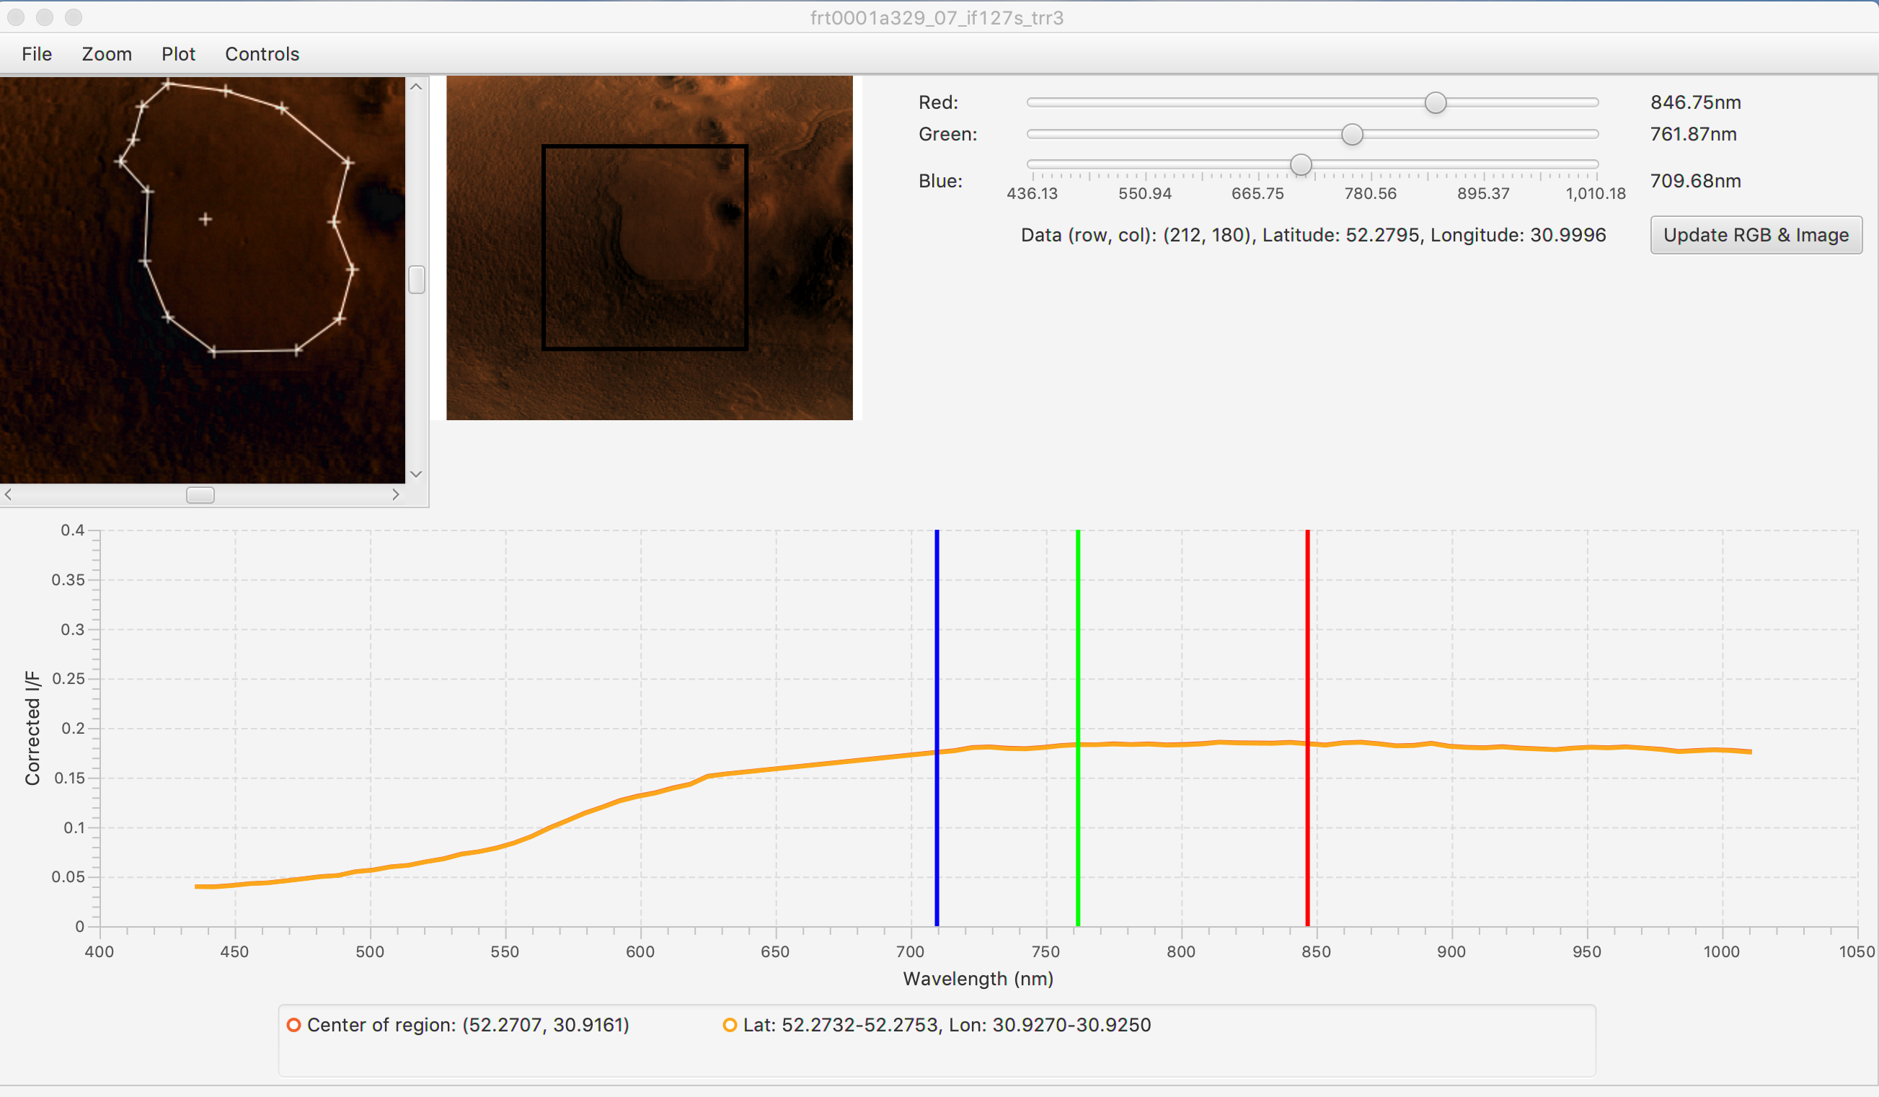
Example Workflow
Let’s compare a point on that mound with the average of its entirety. Go to Controls -> # of Spectra -> Two+. Now, select Click instead of Region of Interest under Spectral Interest.
When adding new spectra onto the chart, use the center click function of the mouse. Since we are clicking, simply center click somewhere on the mound and the spectra will both appear on the chart.

Slide 38
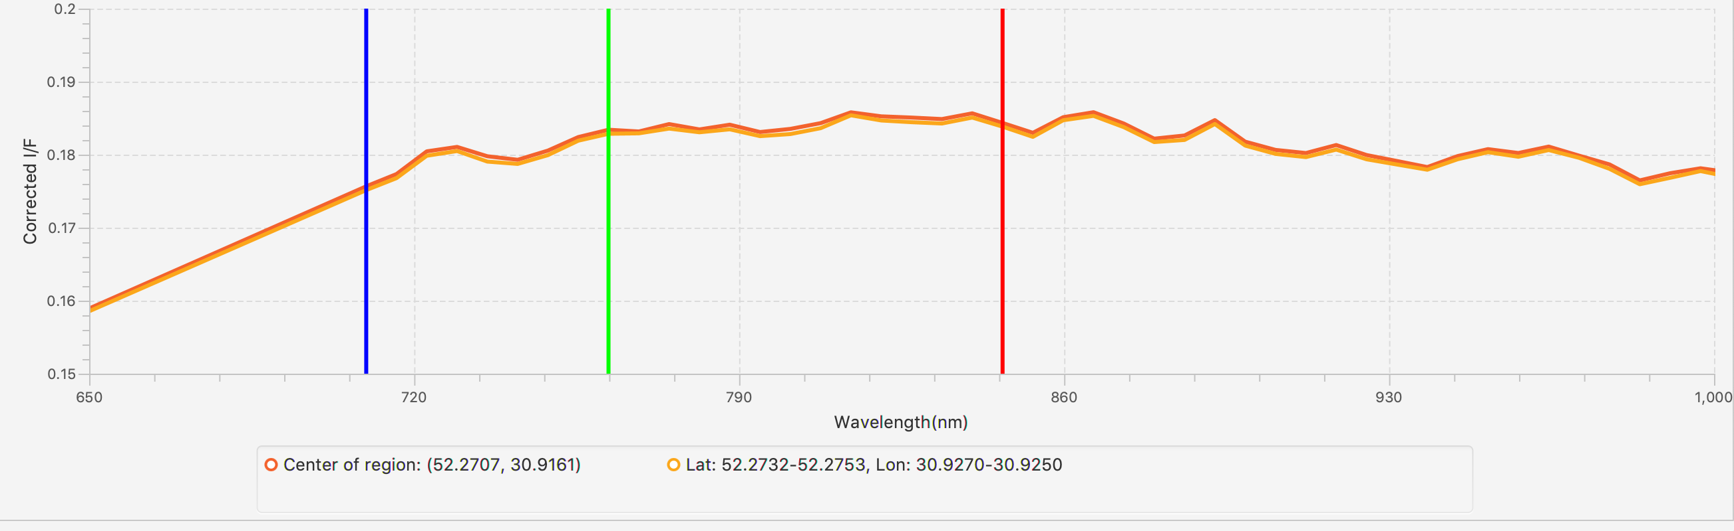
Example Workflow
It’s hard to see any information-carrying features in the spectrum when it is so zoomed out. Go to Plot -> Set X/Y Range to adjust the values you see on screen. To get back, Autoscale Both.

Slide 39
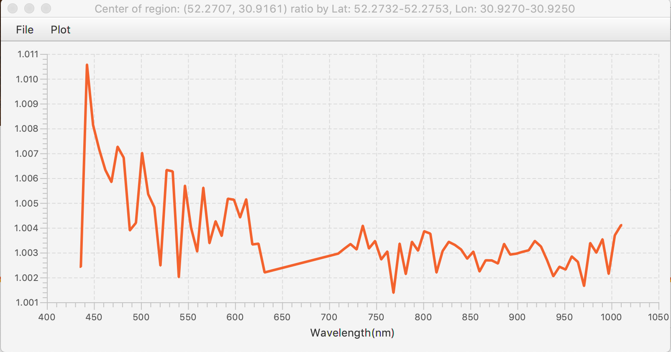
Example Workflow
Looking at the visualization is nice, but sometimes seeing the numbers is better. Go to Controls -> Spectral Operations. Ratio the two spectra and see the resulting plot.
You can also adjust the axes on this chart under the Plot menu.

Slide 40
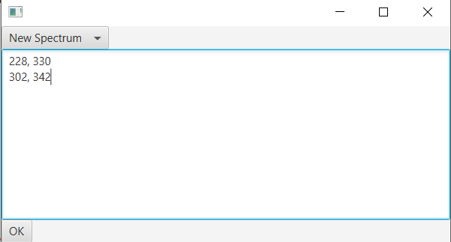
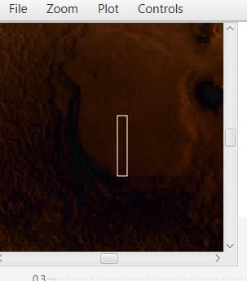
Example Workflow
Instead of clicking around the image, another way of entering data more precisely is by manually inputting the points you would like to see. Select Controls -> Spectral Interest -> Input Manually
In the choice box, select if you would like to create a new chart or add another spectrum onto the existing chart.
In the text box, type what point(s) you wish to see. One point for a single pixel, two points for a rectangular region, or three or more for a region of interest (make sure these are in the order you would like them drawn on the image).
IMPORTANT: the format for these points should be ‘row, col’ – any additional/removed spaces can cause issues with what points end up being used.

Slide 41

Example Workflow
MRO (CRISM)
One type of correction that can be applied to this image is a photometric. This accounts for non-normal solar incidence angles by dividing the scene’s spectrum by the cosine of the incidence angle.
Apply it and select the same point to see the difference.

Slide 42

Example Workflow
In this image, we don’t have to worry. But whenever looking at a TRDR image from the “L” sensor (1000-4000 nm), there is an absorption feature around 2000 nm from CO2 atmospheric interference.
To correct that, go to Controls -> ATP Corrections -> Atmospheric. There are several options. Choose from many or run an optimization routine providing the best correction for your particular image.

Slide 43

Example Workflow
Go under the File menu to save something you like. You can save the current image (.png), chart (.png) or the actual data (.csv).

